Slide 1
SECS:
Efficient Deep Stream Processing via Class Skew Dichotomy

Slide 2
Outline
Motivation
Class skew
Efficient utilizing class skew: probability layer
Class skew dichotomy
Class-specific pruning

Slide 3


Image processing on emerging mobile platforms
Robotics
Glasses
Heavy resource consumption on energy and memory

Slide 4
Existing approaches
Model Pruning
Network quantization: 5x speed up, 7.1% less accuracy
Filter pruning: 4x less computation, 2.81% less accuracy
On-device scheduling
Dynamically select smaller model according to runtime resource budget
4x less latency, 4% less accuracy.
Existing approaches all trade accuracy for less resource consumption
Notes:
Resnet 18

Slide 5
Our approach: Class skew
Definition: a few classes appear in an environment, while others appear seldomly or does not appear at all.
Through one year: thousands of people
In lab: less than ten people
Both reduce resource consumption and increase accuracy

Slide 6
Basic example: class skew
Through one year: thousands of people
In lab: less than ten people
Less classes required in lab
Need a small model with 10 classes
Replace the complex model with 1000 classes
Less classes means
Higher accuracy
Less resource consumption
Notes:
Make left one look like the right one

Slide 7
Efficiently utilize runtime class skew
Existing approach: Reduce number of nodes in the last layer and finetune the last few layers.
Challenge: Class skew may switch frequently as time goes, i.e., every 5 minutes. However, existing approaches would take at least 14 seconds latency or even minutes, as well as lots of computation.
Our approach: An efficient model adaption approach that can adapt model without any overhead during runtime.

Slide 8
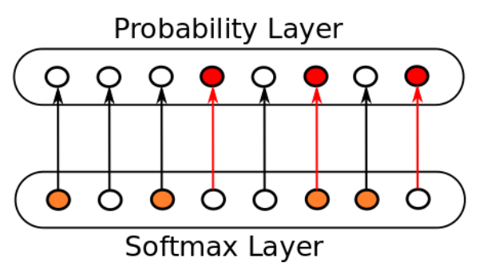
Efficiently utilize runtime class skew: probability layer
An extra layer after the original model.
Only need to modify parameters in the last layer.
No overhead is introduced.

Slide 9
Further observation: class skew dichotomy
Hot class skew appear frequently in the future
Cold class skew never appear again
Inspired by techniques from source code optimization, two modes are designed for hot/cold class skew.
Interpretation for cold class skew: efficient adaption during runtime with probability layer
Compilation for hot class skew: aggressive optimization on the model by class-specific pruning.

Slide 10
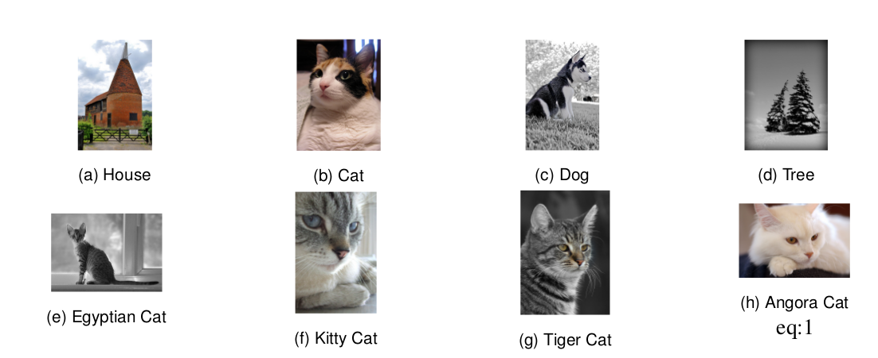
Class-specific pruning: motivation
Some classes are easier to distinguish while others are hard
Small models for simple classes and complex models for hard ones

Slide 11
Class-specific pruning: perforation
Different class skew requires different model architecture.
Small models for simple classes and complex models for hard ones
Automatically decide the hyperparameters, i.e., layer, channel, neurons.
Challenge: Retraining is required for every new hyperparameter.
Our solution: Use perforation to recover the feature maps size to enable the forward computation.
Generate a sequence of models with increasing accuracy without any finetune.

Slide 12
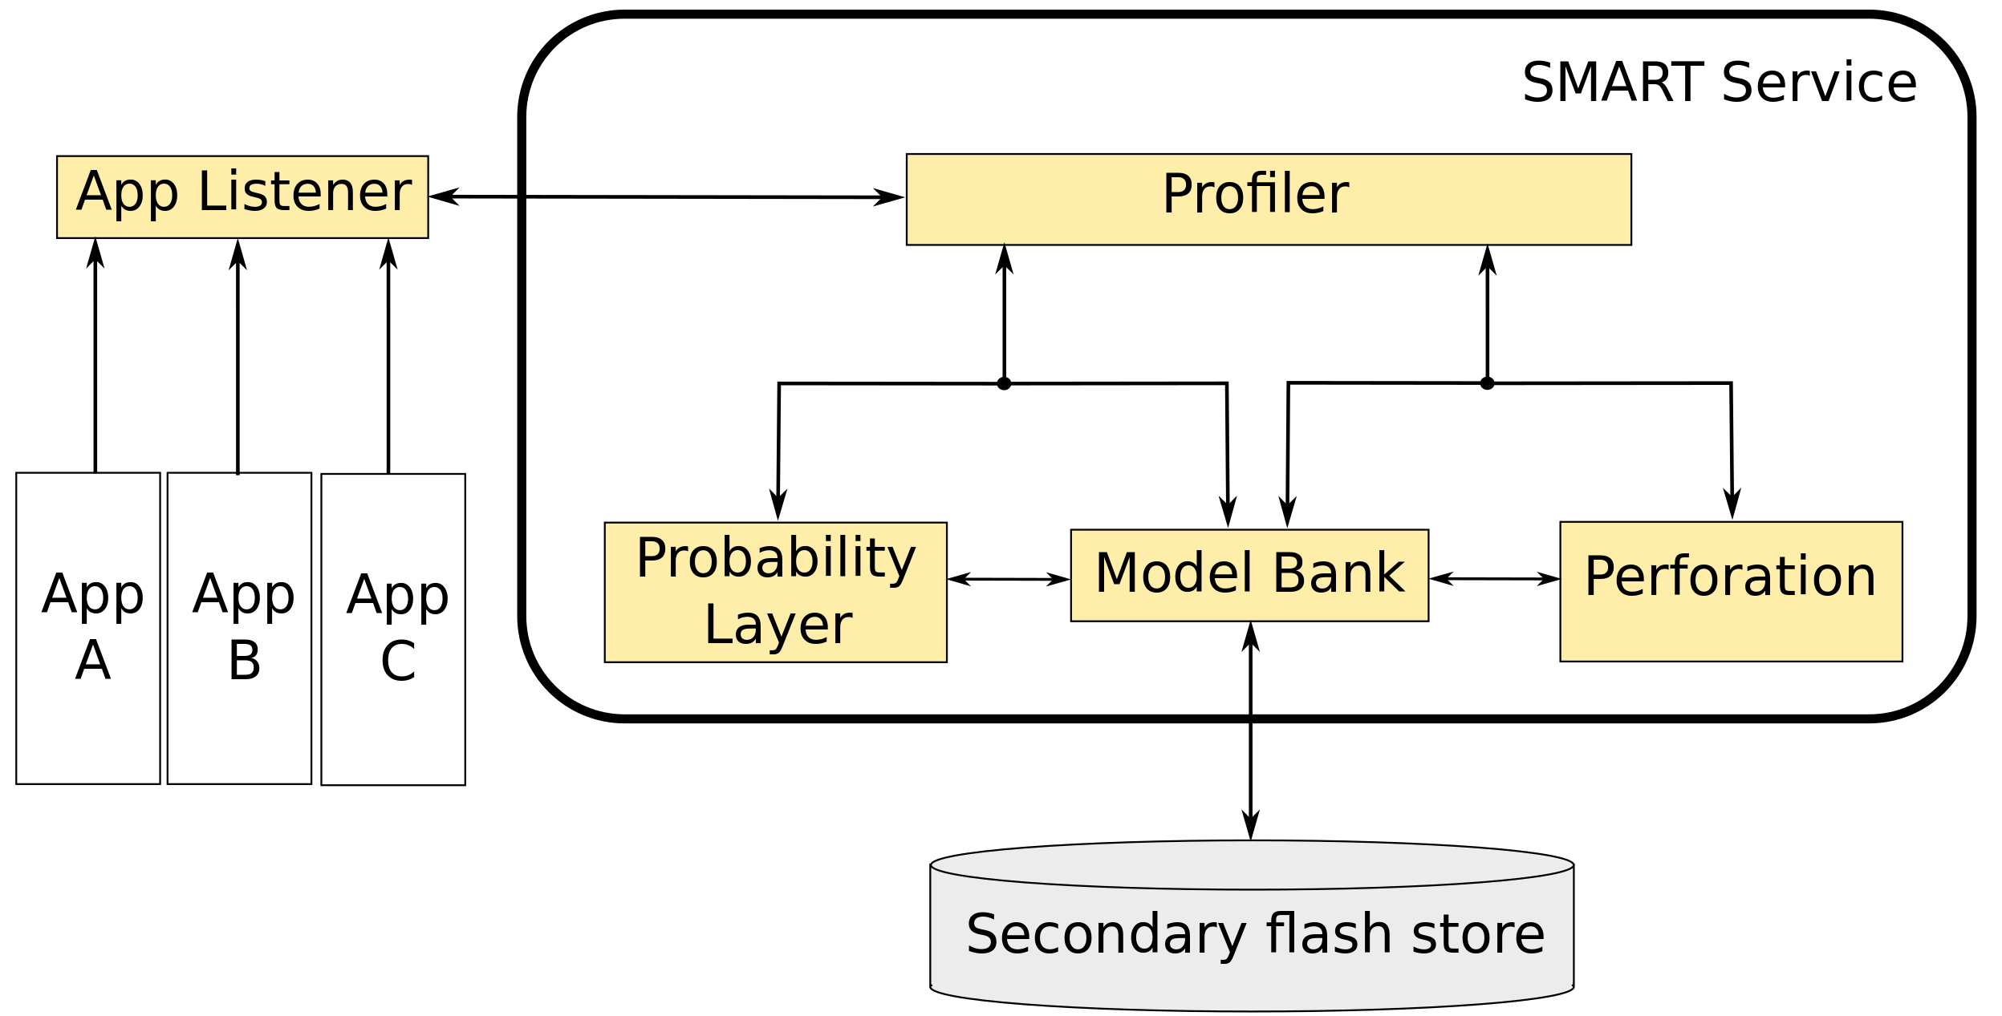
SECS Architecture
Profiler for detecting class skew
Probability layer for efficient model adaption during runtime
Perforation for class-specific pruning

